Slide 1
Welcome to the EAGE Annual Hackathon! Final Presentations and Awards

Slide 2




Thank you to our sponsors who made this possible!
Supported by

Slide 3
This session is being recorded.
If you have not received a consent form please email the facilitators asap.

Slide 4

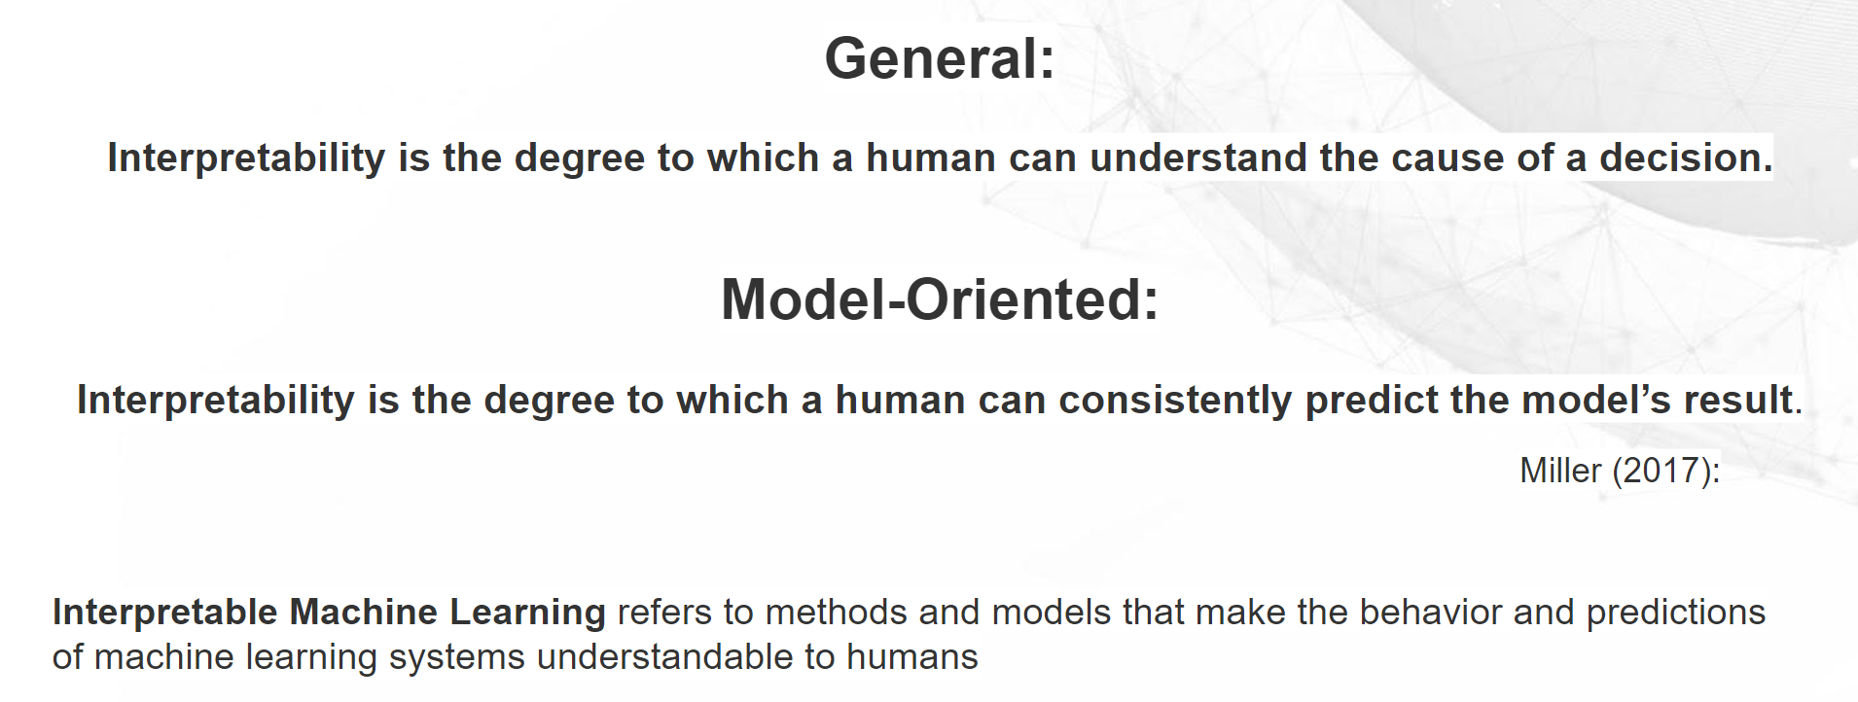
The Theme: Explainable AI

Slide 5
Awards!
There are two awards up for grabs.
These two teams will have their final presentations replayed in the AI special session during the annual meeting!
The winners will also be awarded free access codes for self-paced online courses from NVIDIA Deep Learning Institute
“Best in Show”
A panel of judges will join us for the presentations on the last day and will award this prize.
“Audience Choice”
Each hacker will vote for their favorite team (not their own) and the team with the most votes wins this one!

Slide 6
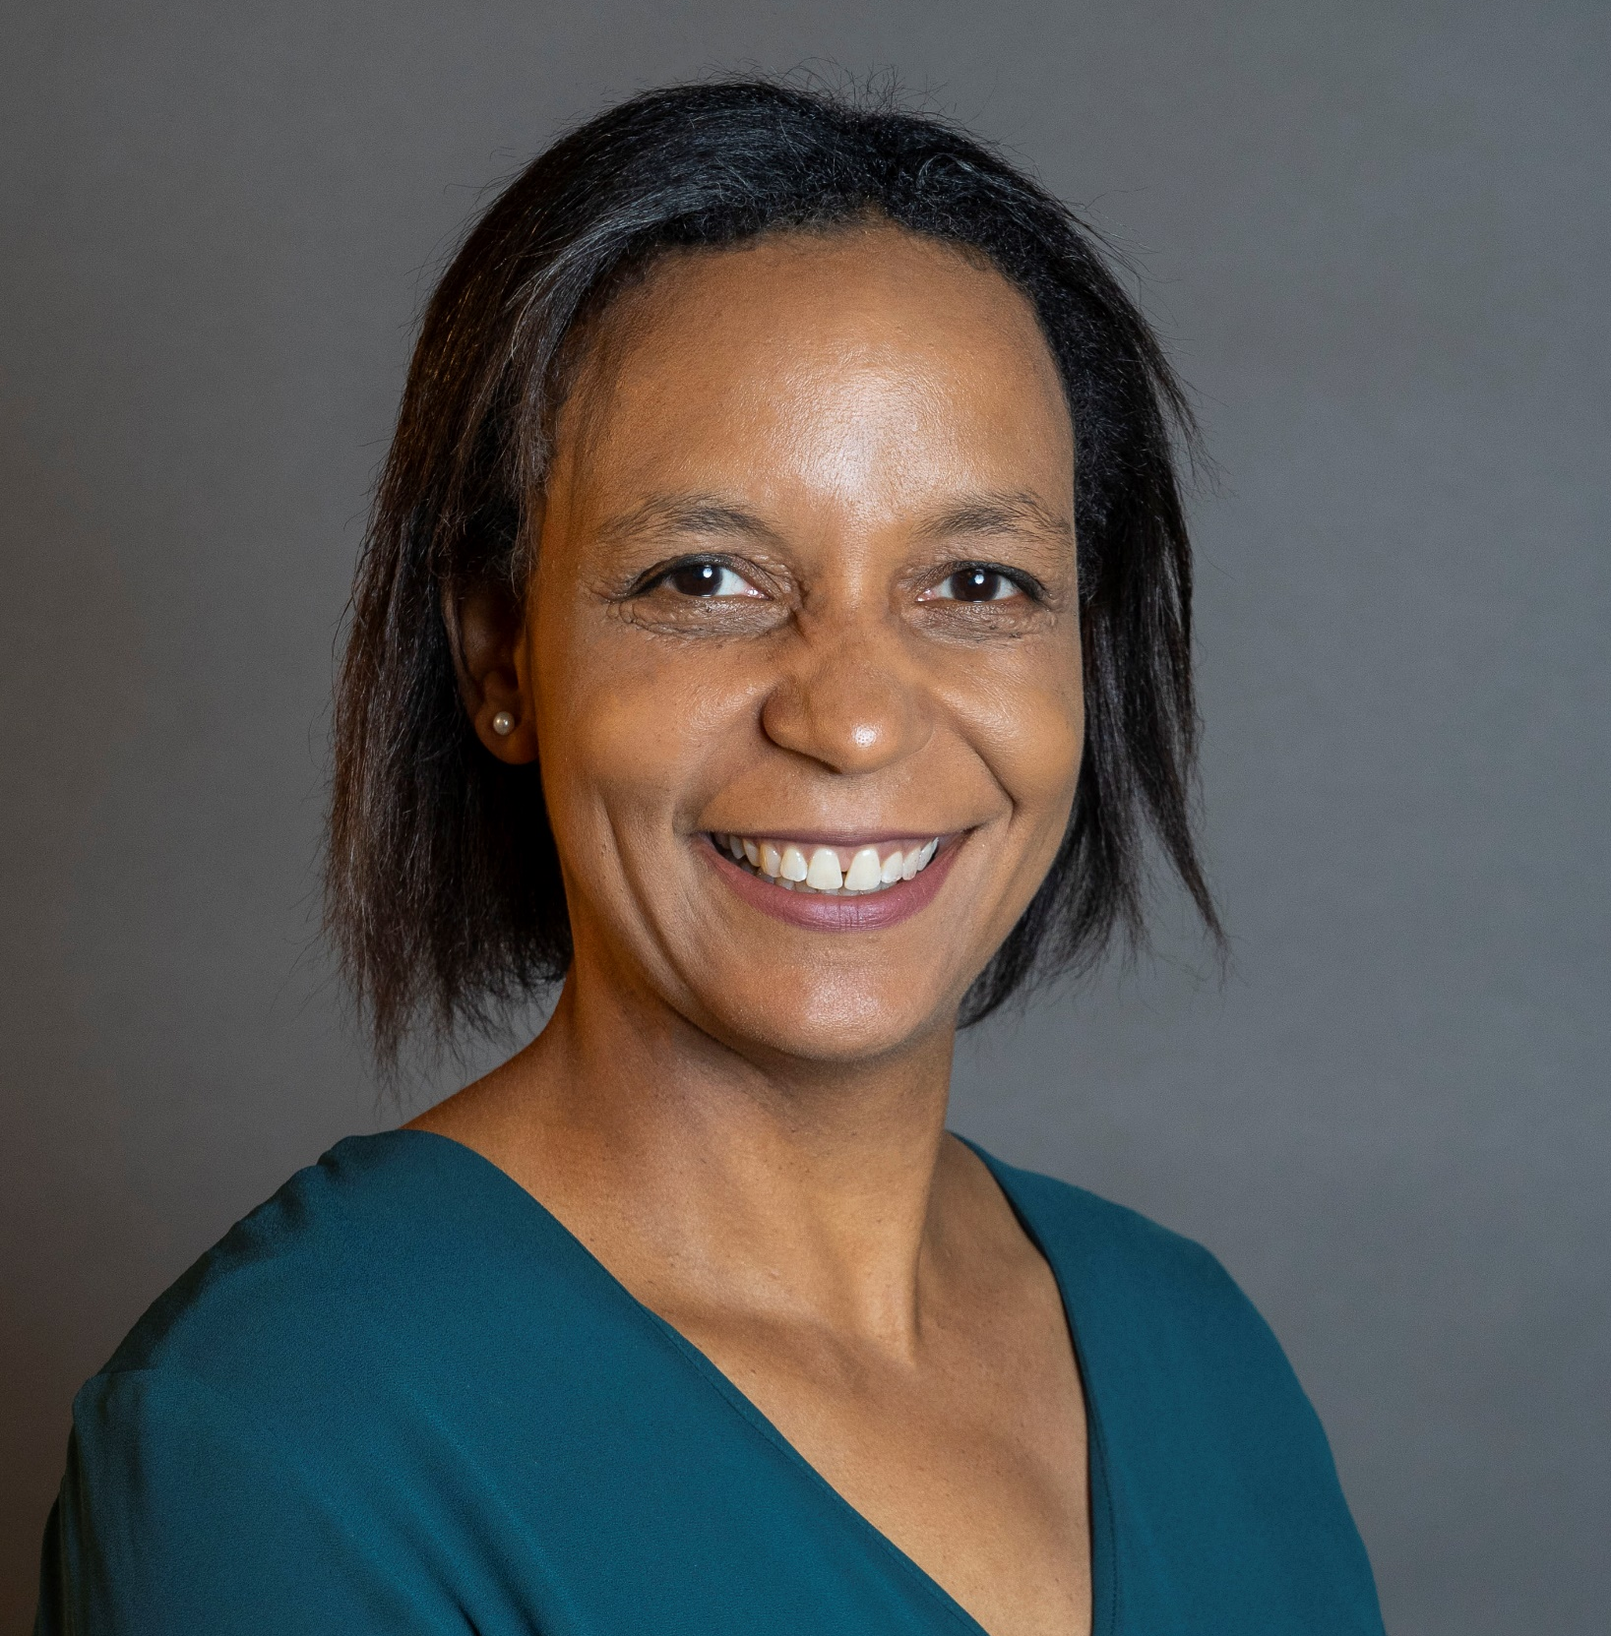
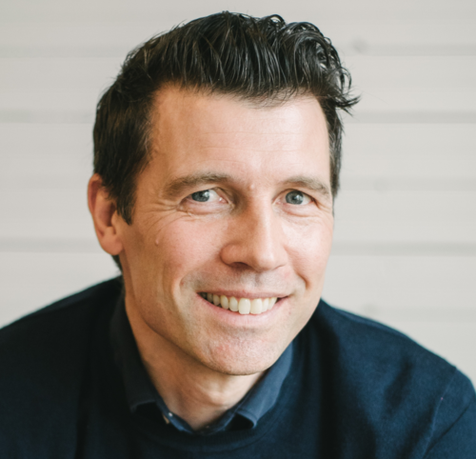
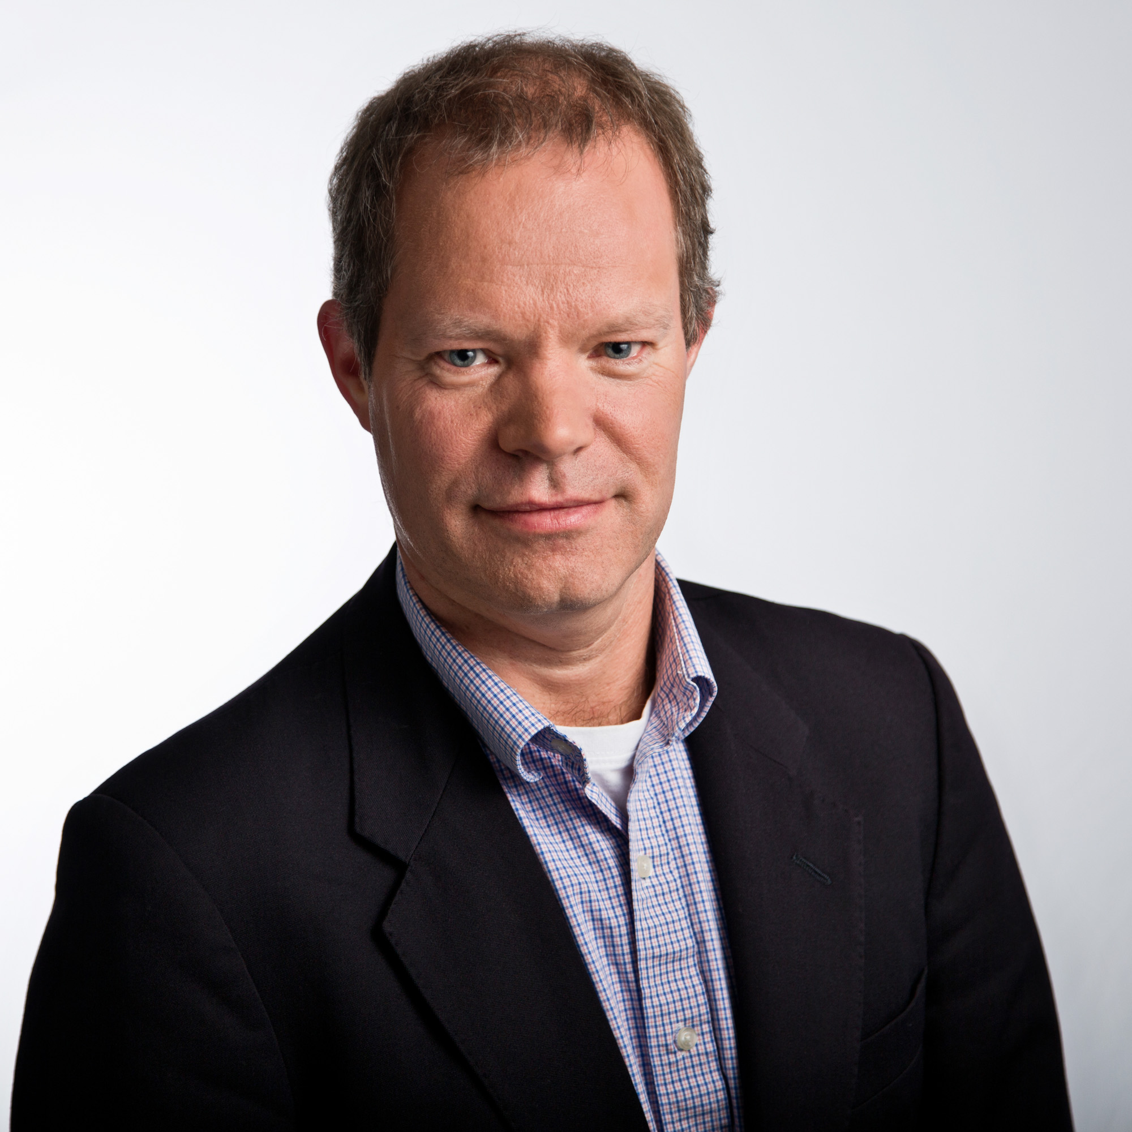
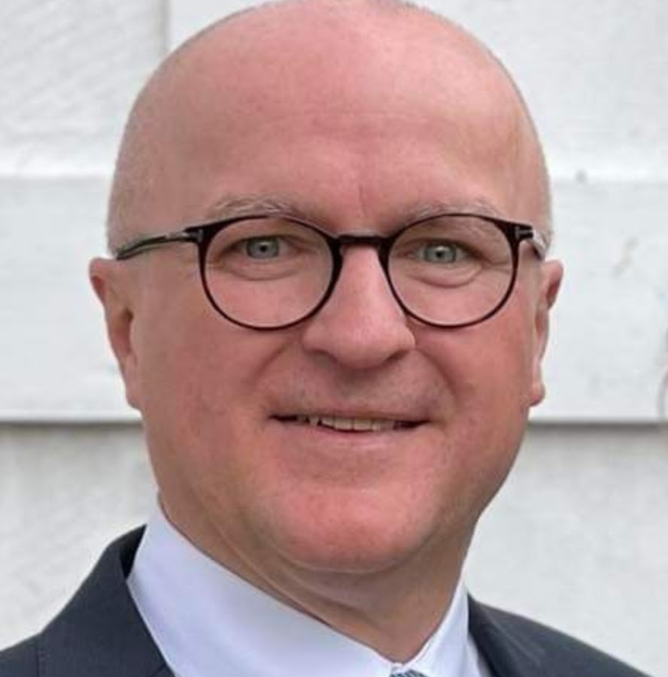
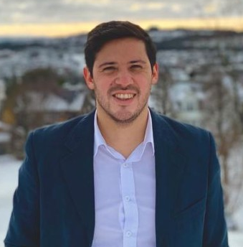
Meet Your Judges
Maisha Amaru
Research Geophysicist
Computational Reservoir Geophysics
Chevron
Matt Hall
Founder/CEO/
Programmer
Agile Scientific
Roald van Borselen
Chief Representative Global Research Center Delft
Saudi Aramco
Victor Aarre Madsen
Geophysics Advisor
Schlumberger
Javier Sotillo
Sales Manager
Earth Science Analytics
Notes:
Maisha: Maisha Amaru has a PhD in Geophysics from Utrecht University in the Netherlands. She joined the industry and Chevron in 2007 and worked on applied and research projects around velocity modeling, seismic imaging, and uncertainty analysis. In recent years, Maisha has been focusing on performing research and managing projects that integrate geology and geophysics, including the use of machine learning technologies for seismic interpretation.
Matt has a PhD in sedimentology (Manchester, UK), and 25 years’ experience in the energy industry. He has worked for Statoil, Landmark, and ConocoPhillips as a geophysical advisor. Matt has written various articles, talks, and book chapters, and edited 3 books. He founded Agile in 2010 as a small but perfectly formed scientific computing company.
Roald MSc Applied Geophysics, Delft University
PhD Applied Geophysics, Delft University
MBA, Surrey University
26 years industry experience, Aramco, PGS, Saudi Aramco
Currently: Chief Representative Global Research Center Delft, The Netherlands
Victor: I am the Geophysics Advisor for the Schlumberger Norway Technology Center (SNTC). Our main commercial product is the Petrel E&P software platform. I have worked in various Research & Engineering positions in Schlumberger since graduation, mainly within the seismic industry. In the early days I focused on shear-wave anisotropic velocity model building and imaging, before I moved on to concentrate on reservoir characterization and time-lapse seismic monitoring. My current personal research focus is on seismic noise attenuation, fault/fracture mapping, automatic Earth Model Building and Machine Learning/AI technologies.

Slide 7
Judging Criteria
Presentations will be scored based on the following:
- Relevancy to the theme of Explainable AI (Did the presentation demonstrate the team’s ambition to make machine learning more human-interpretable?)
- Understandable – was there a good explanation of the challenge and the solution direction
- Presentation skills and presentation quality (was there a demo? was the presentation engaging and flowed properly?) Note that some teams might not get to a working solution - do not judge them on this - but instead on the effort and ideas on approaching the challenge (what did they try, why did it fail, what would they do different?)

Slide 8
Agenda of Final Presentations
Each team will have 8 minutes to present their challenge and their approach to solving it.
This will leave time for 1-2 questions from the judges
The order (randomly assigned)

